Slide 1
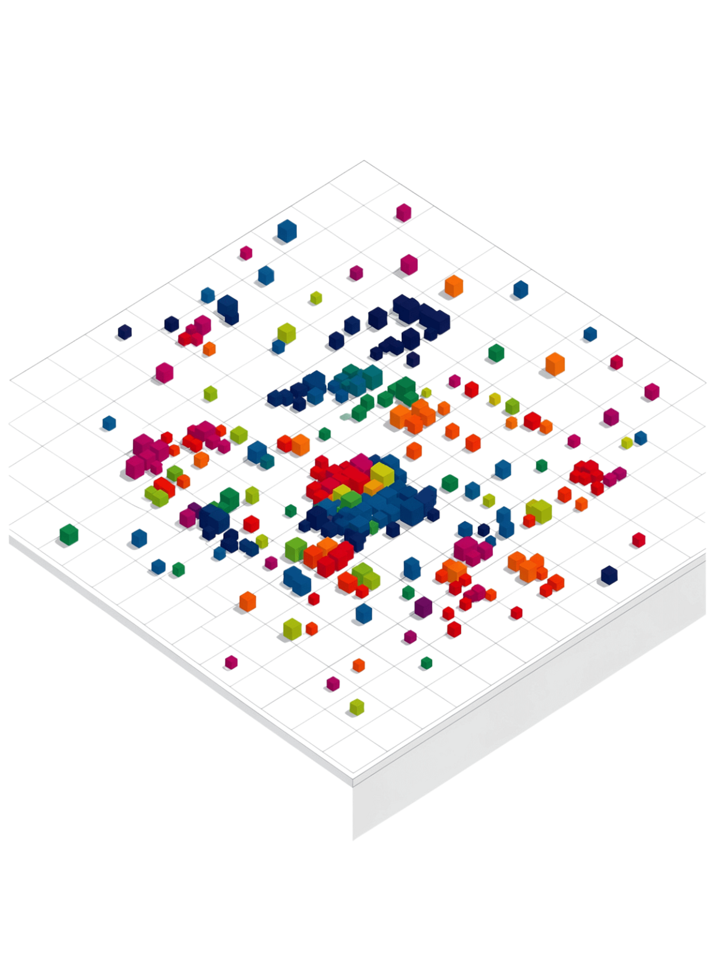
K-Means Clustering
An unsupervised learning algorithm that groups similar data points together — no predefined labels required. K-Means discovers hidden structure in unlabeled data by partitioning it into K distinct clusters.
Customer Segmentation
Group customers by behavior and preferences
Image Compression
Reduce colors by clustering similar pixel values
Document Clustering
Organize text by topic similarity
Market Segmentation
Identify distinct market groups automatically
Unlabeled Data → K-Means → Clusters

Slide 2
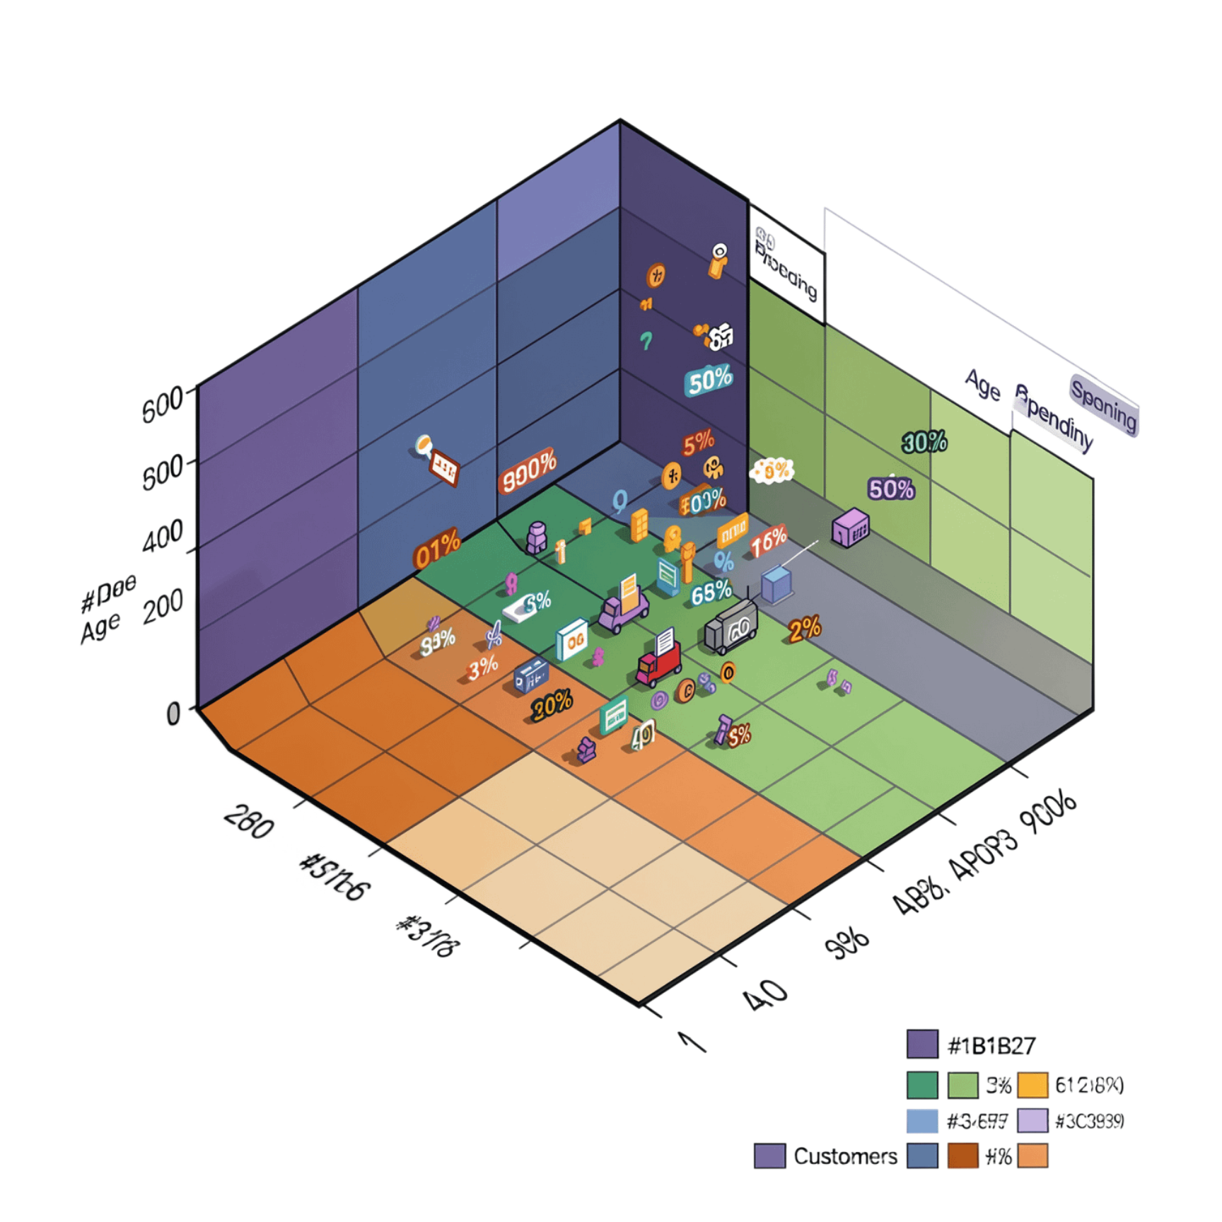

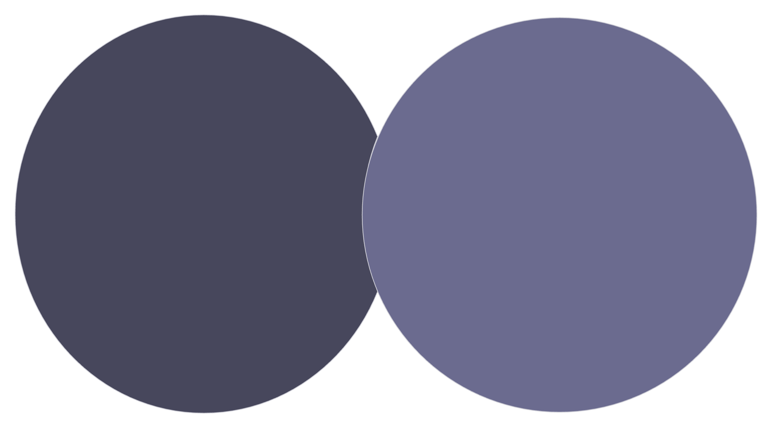
Understanding Clustering
What Is a Cluster?
A cluster is a group of data points that are more similar to each other than to points in other clusters.
Consider a dataset of customers described by:
Age
Annual Spending
Initially, all customers appear as unlabeled points on a scatter plot. K-Means discovers that visually similar customers naturally form groups — without ever being told their labels.
The algorithm finds these groups on its own. No human labeling is needed — that's what makes it unsupervised.
Emerging Clusters
All Customers
Age vs annual spending plot
Three color-coded customer groups
Customers with similar age and spending patterns naturally cluster together — K-Means surfaces these hidden groupings automatically.

Slide 3



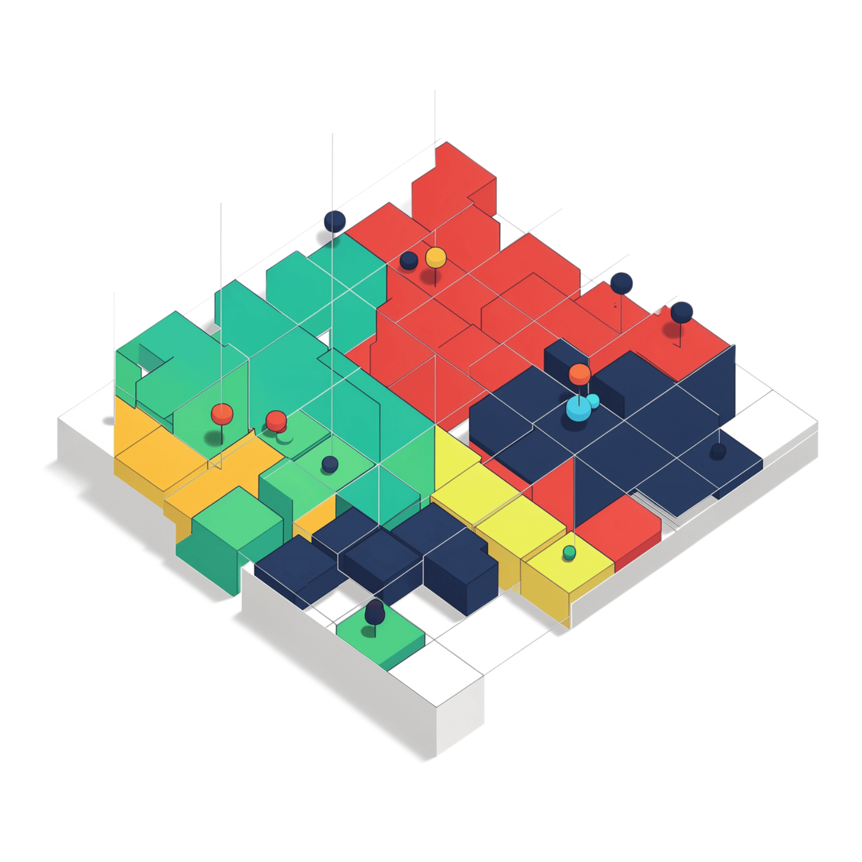
What Does "K" Mean?
K = the number of clusters you instruct the algorithm to find. Choosing K is one of the most important decisions in the entire process.
K = 2
K = 3
K = 4
Dataset split into 2 clusters — broad, coarse groupings
Dataset split into 3 clusters — often the natural sweet spot
Dataset split into 4 clusters — finer granularity, more segments
Same Data, Different K
The scatter plots to the left illustrate how the same dataset produces very different groupings depending on the value of K chosen.
Too few clusters → groups are too broad and lose detail
Too many clusters → groups become artificially fragmented
The right K → captures the true natural structure of the data
Selecting the optimal K requires methods like the Elbow Method or Silhouette Score — covered later in this presentation.

Slide 4
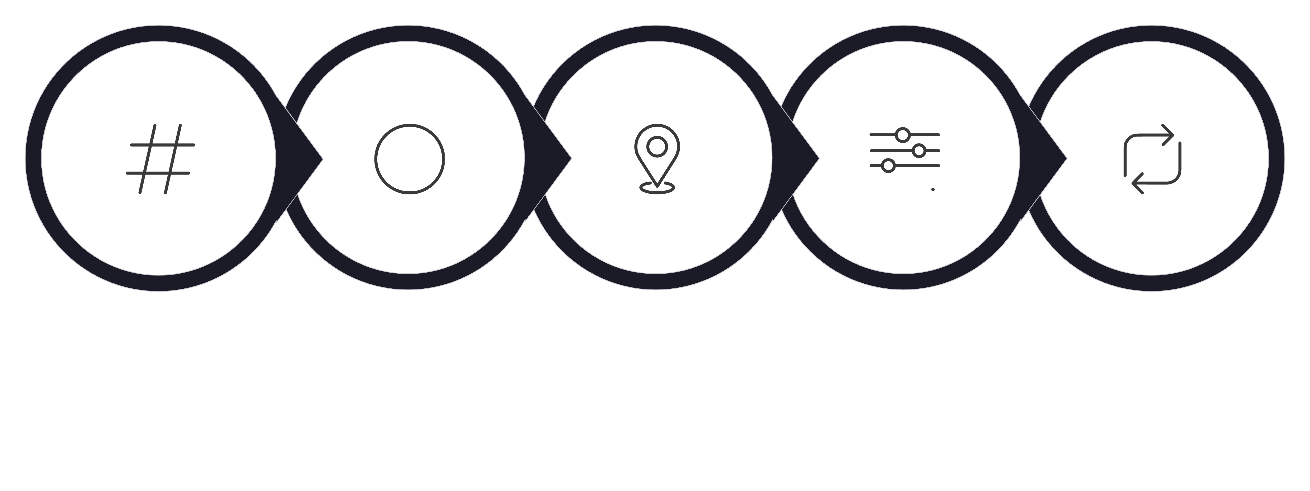
K-Means Algorithm Step-by-Step
Choose K
Init Centroids
Assign Points
Recalculate
Repeat Loop
K-Means is an iterative algorithm. It alternates between assigning points to the nearest centroid and recalculating centroid positions until the clusters stabilize.
1
Choose K
Decide how many clusters to find before the algorithm starts.
2
Initialize Centroids
Randomly place K centroids in the feature space.
3
Assign Points
Each data point is assigned to its nearest centroid using Euclidean distance.
4
Recalculate Centroids
Move each centroid to the mean position of all points assigned to it.
5
Repeat
Repeat assignment and recalculation until centroids stop moving significantly.
6
Convergence
Stop when assignments and centroids no longer change — the algorithm has converged.

Slide 5
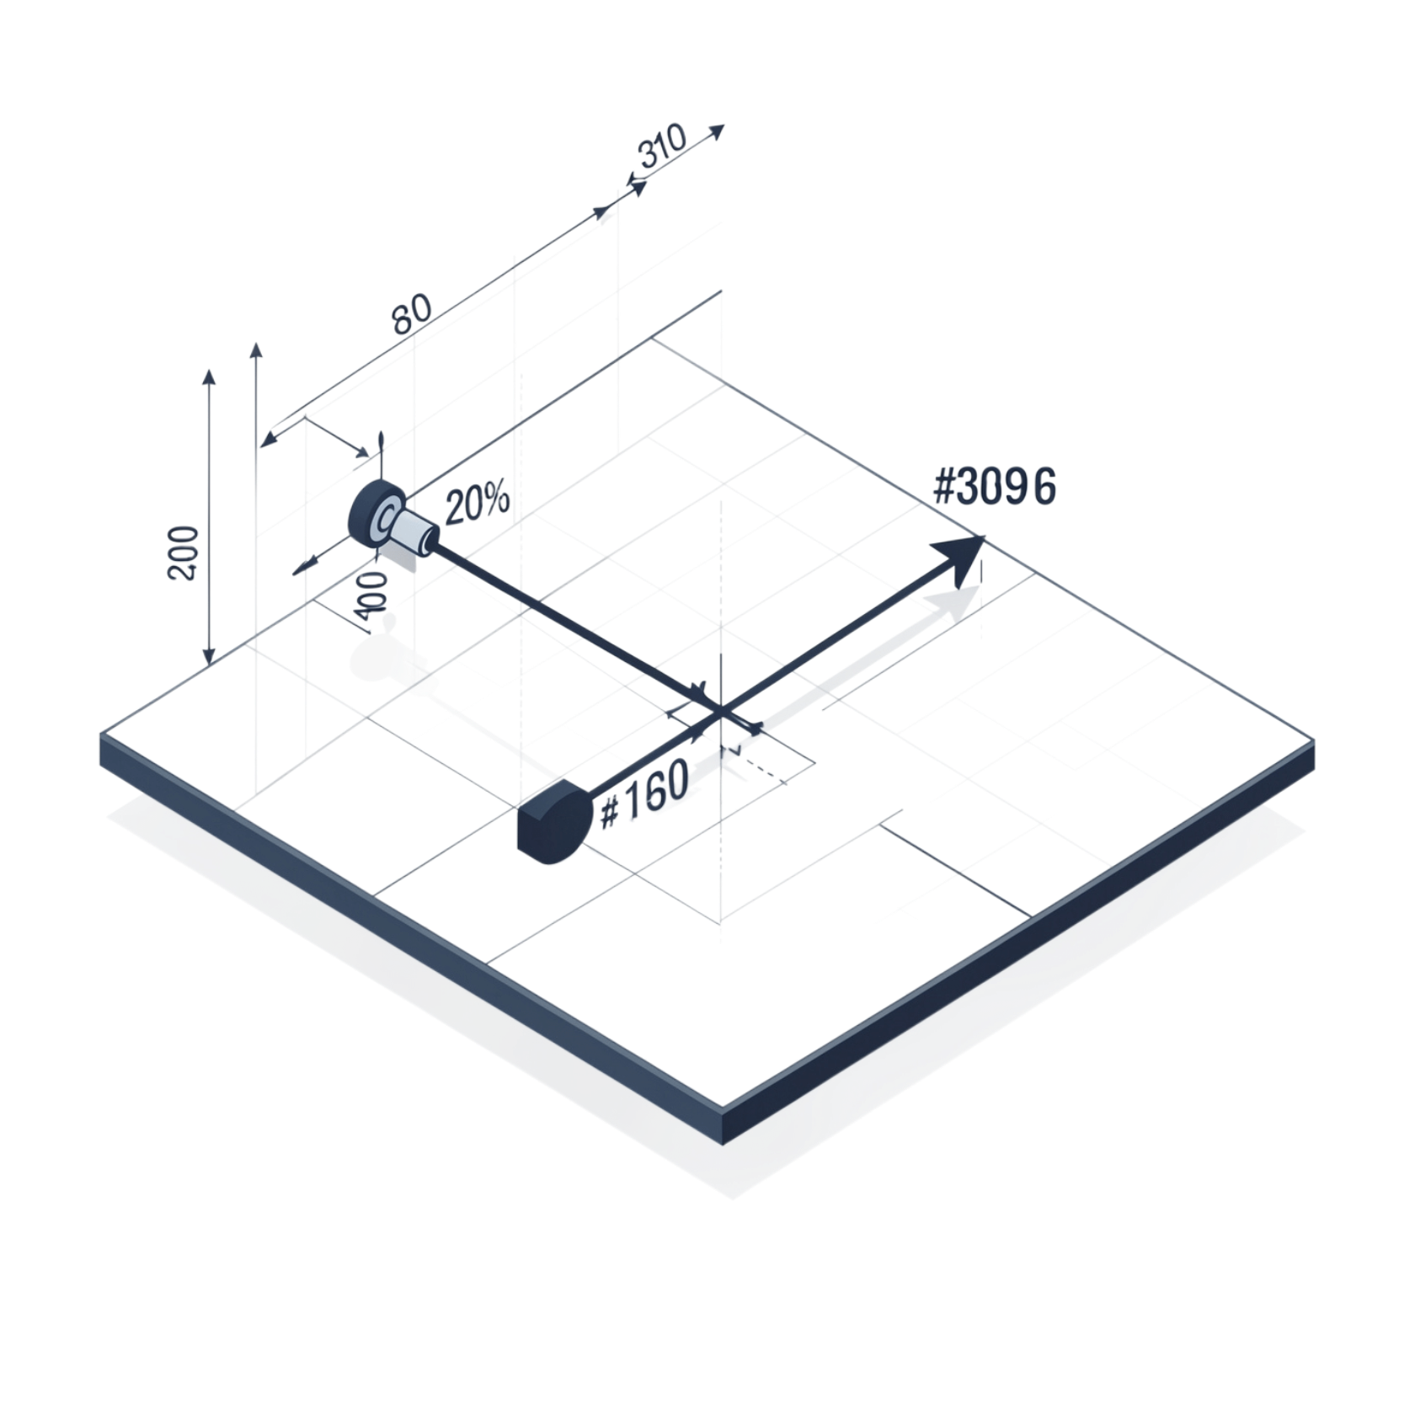
Distance Calculation
Euclidean Distance
K-Means decides which cluster a point belongs to by measuring its distance to each centroid. The point is assigned to the nearest centroid.
d = Distance between two points
x₁, y₁ = Coordinates of the first point
x₂, y₂ = Coordinates of the second point
Worked Example
Point A = (2, 3) Centroid = (5, 7)
K-Means repeats this calculation for every centroid and assigns the point to whichever centroid yields the smallest distance.

Slide 6
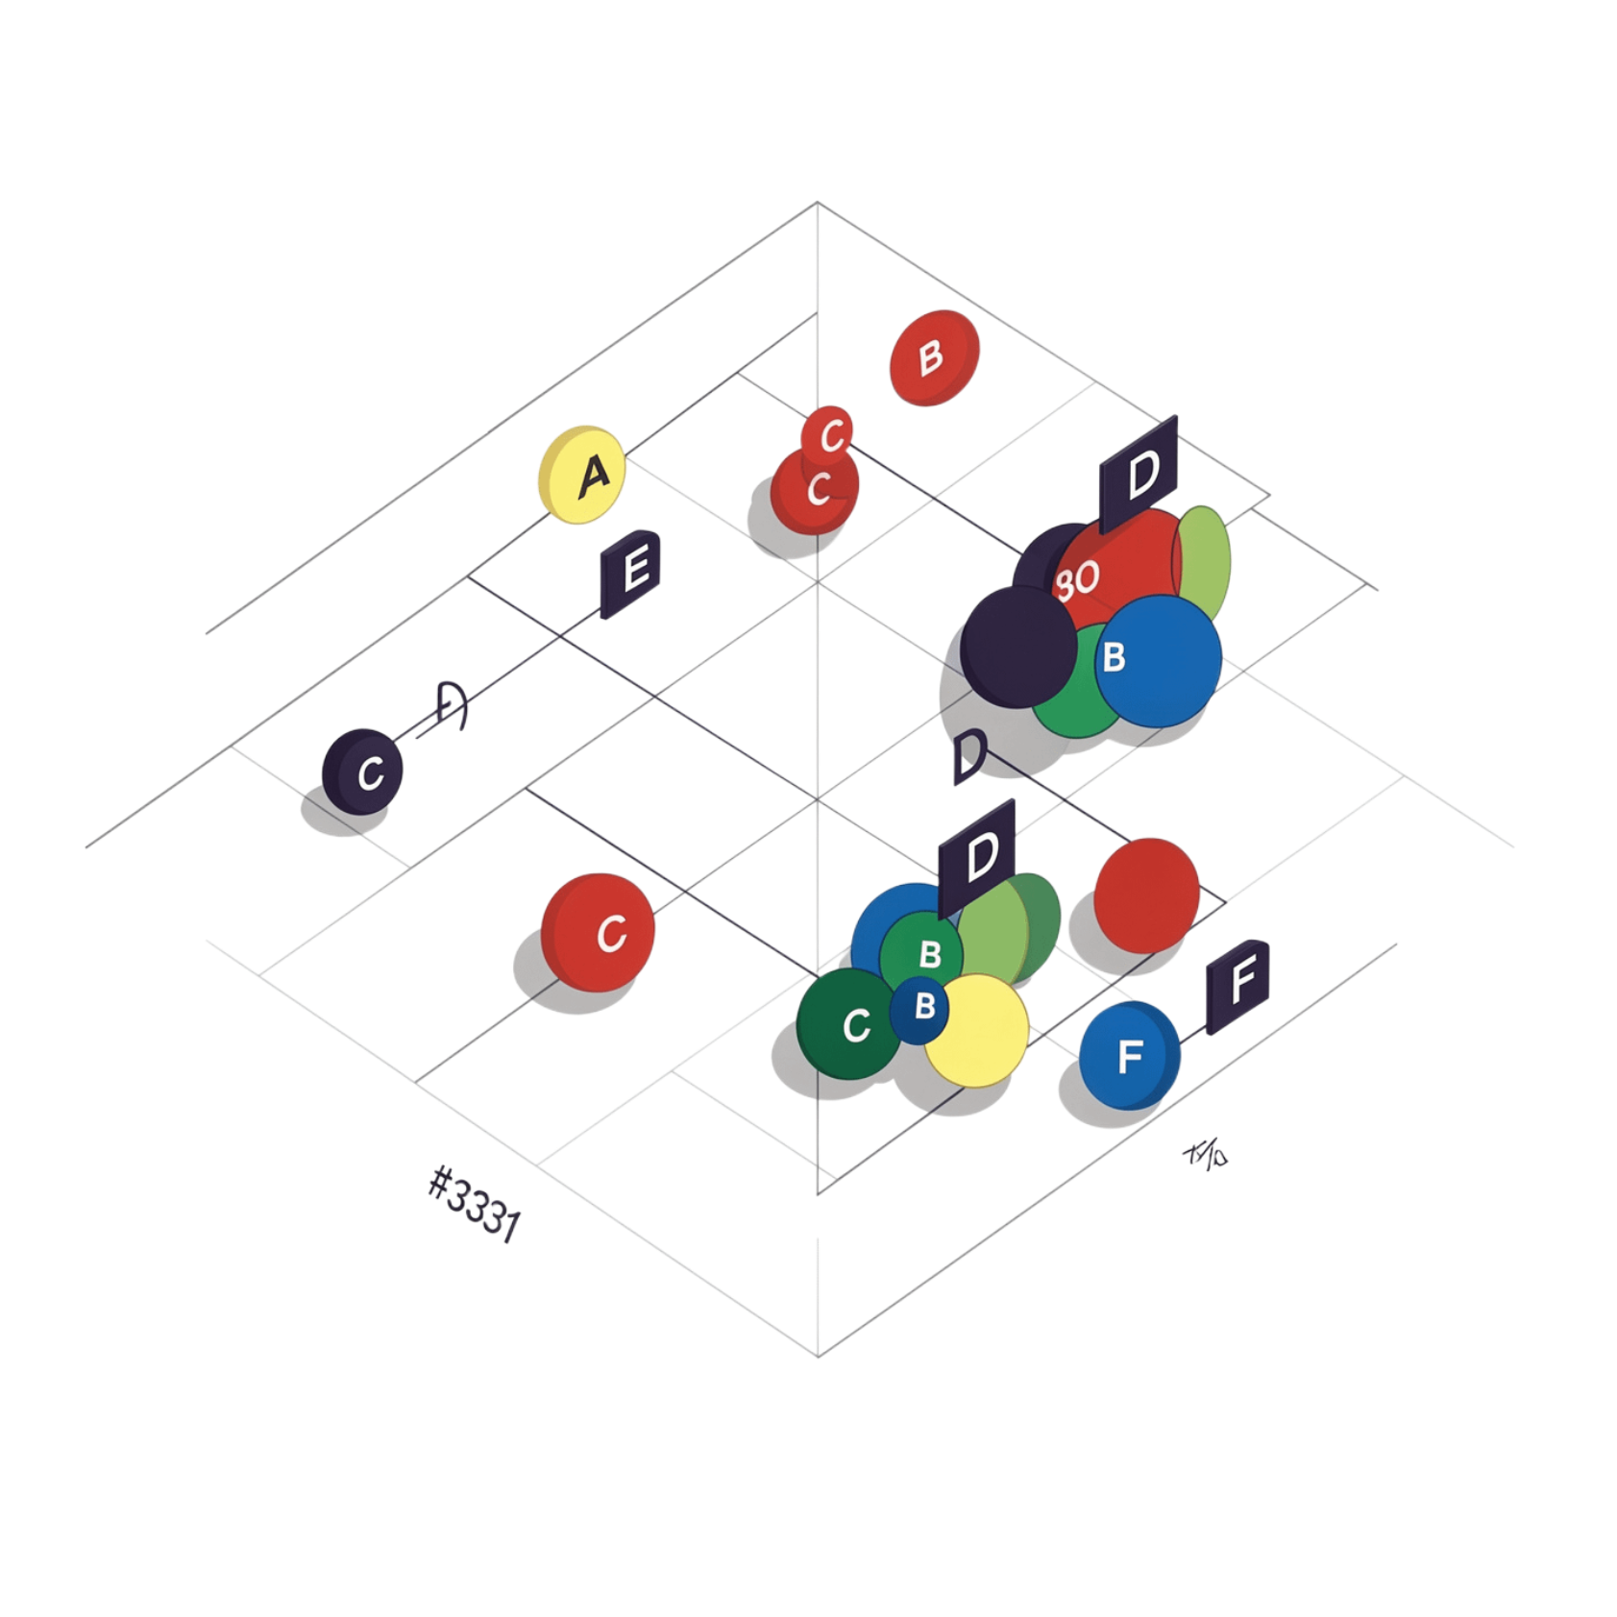
Complete K-Means Numerical Example
K = 2 | Initial Centroids: C₁ = (1, 1) C₂ = (8, 8)
Point | X | Y | Assigned Cluster
A | 1 | 1 | C₁
B | 2 | 1 | C₁
C | 1 | 2 | C₁
D | 8 | 8 | C₂
E | 9 | 8 | C₂
F | 8 | 9 | C₂
Worked Distance: Point B = (2, 1)
→ Point B is assigned to C₁ (distance 1 < 9.2)

Slide 7
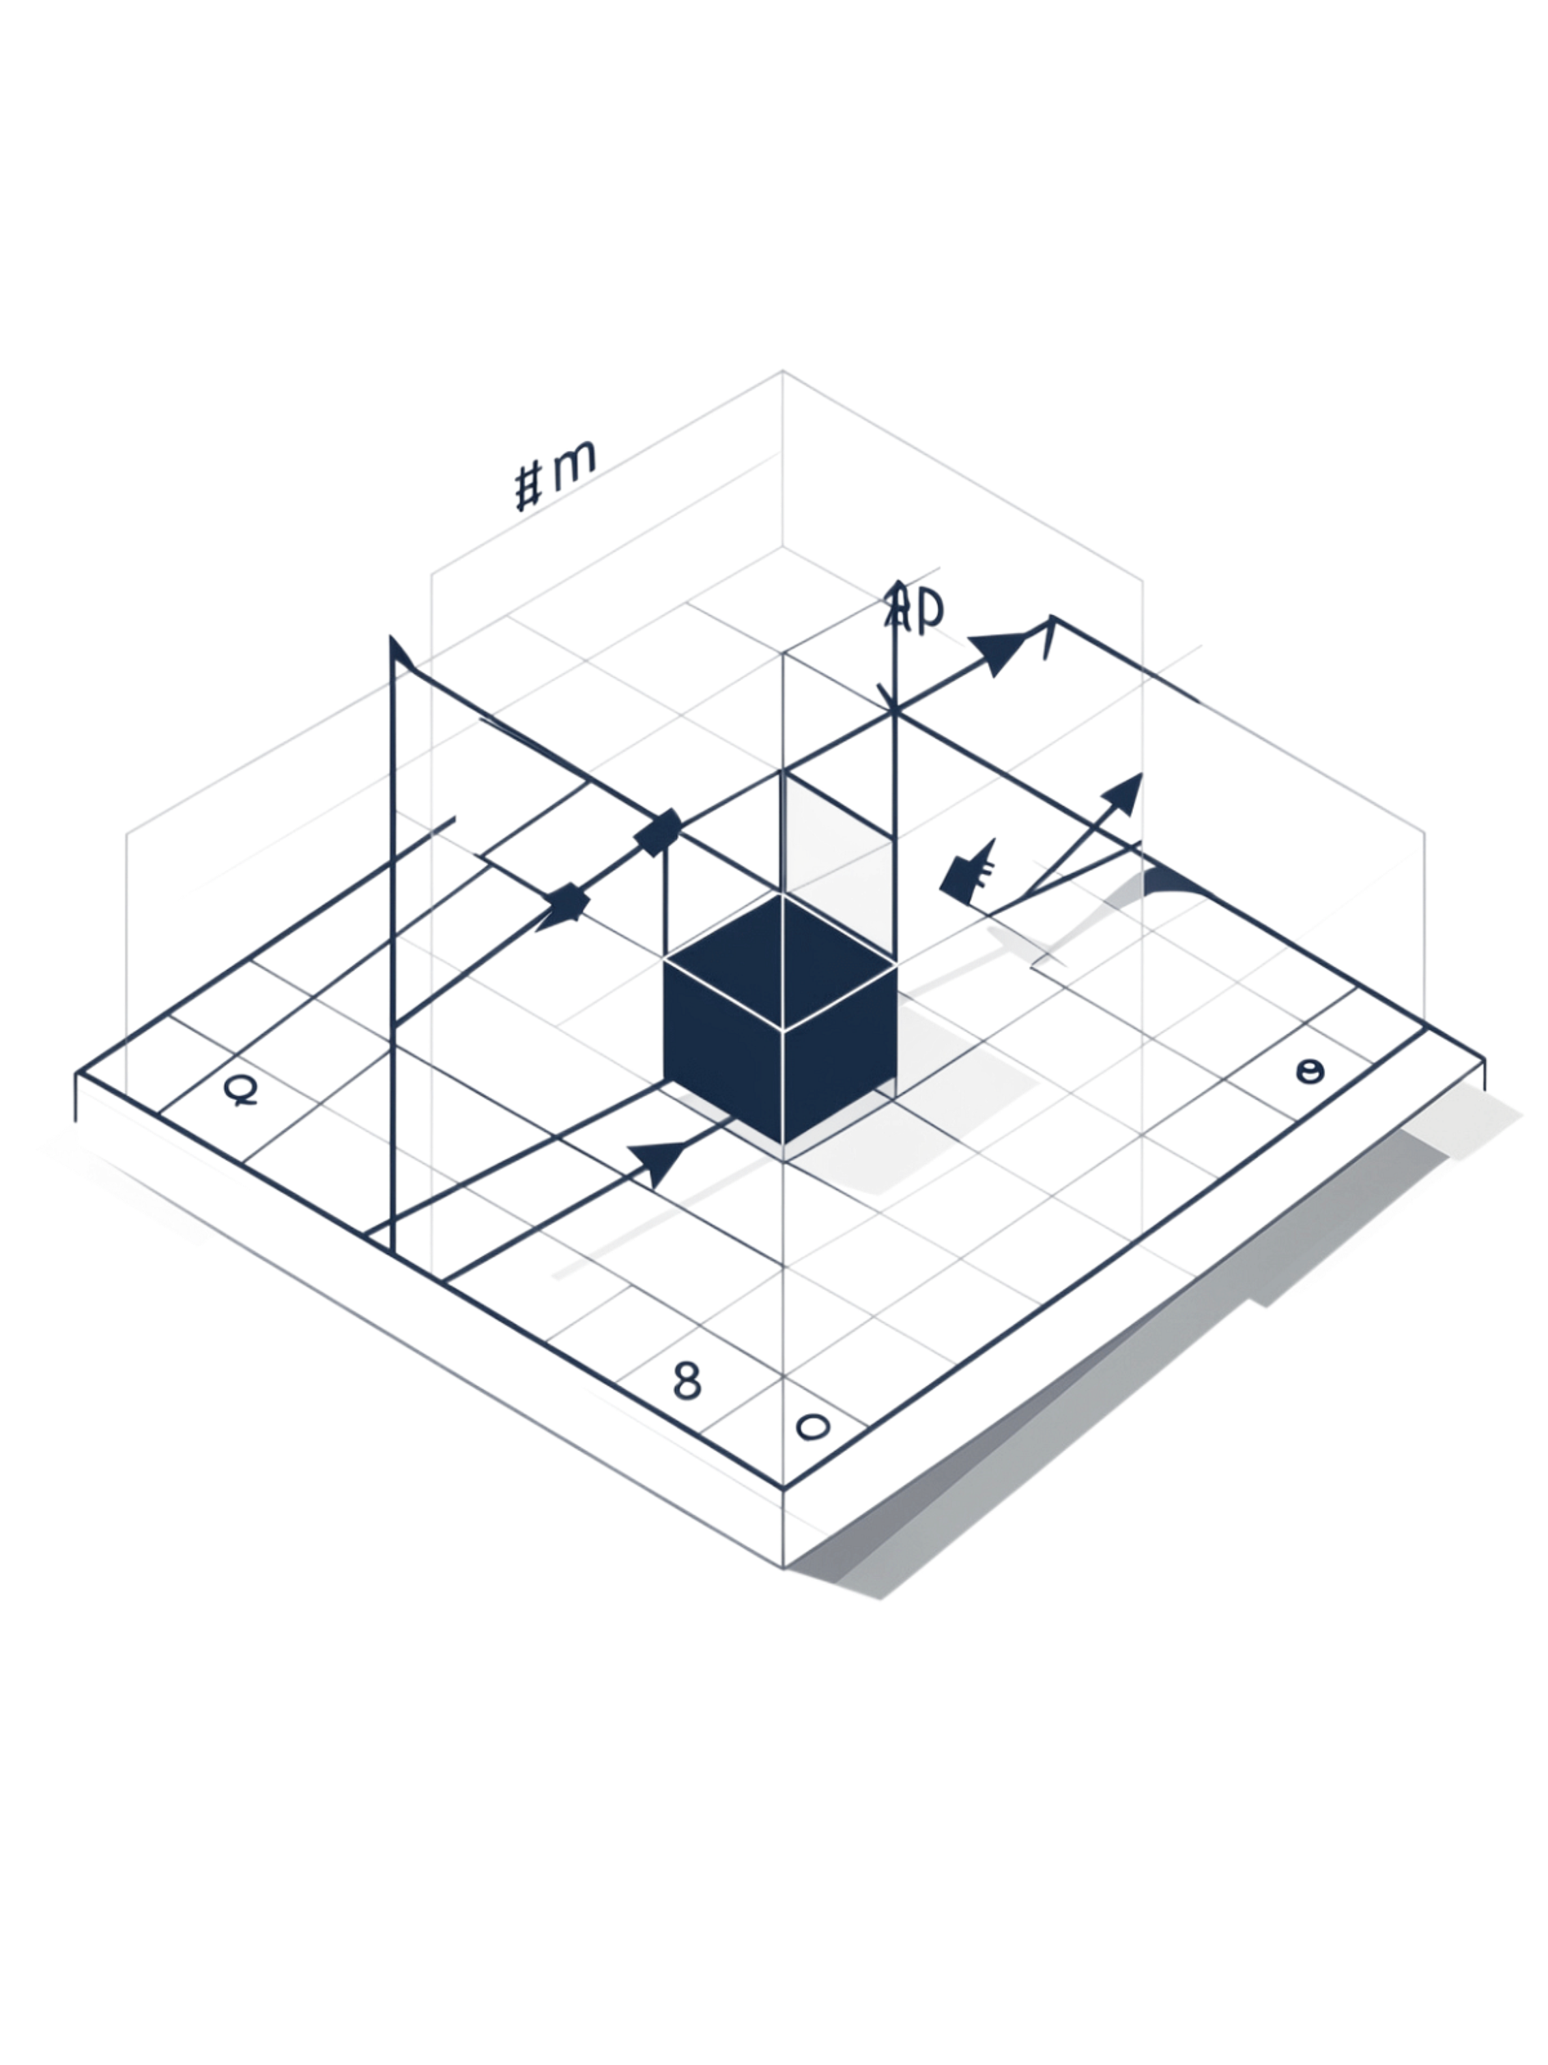
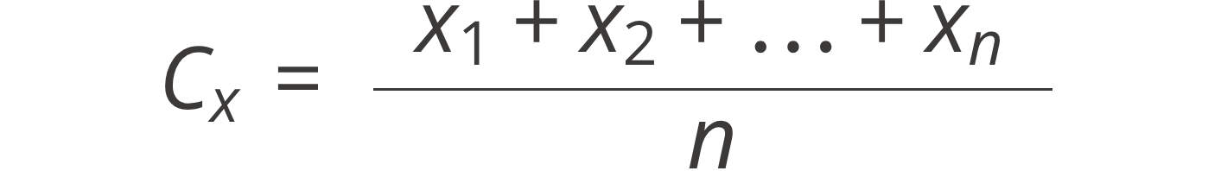
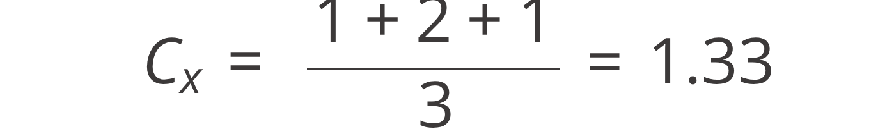

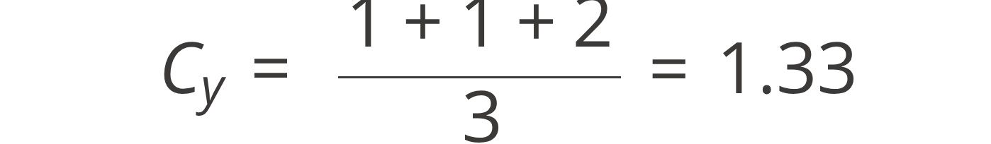

Updating the Centroids
Centroid Formula
After assigning all points to clusters, K-Means recalculates each centroid as the mean of all points in that cluster.
The Formula
Worked Example — Cluster 1
Points: (1,1), (2,1), (1,2)
Where n is the number of points in the cluster.
Initial centroid was at (1, 1).
New centroid moves to (1.33, 1.33).
The centroid shifts toward the true center of mass of its assigned points. This movement is what drives convergence.

Slide 8
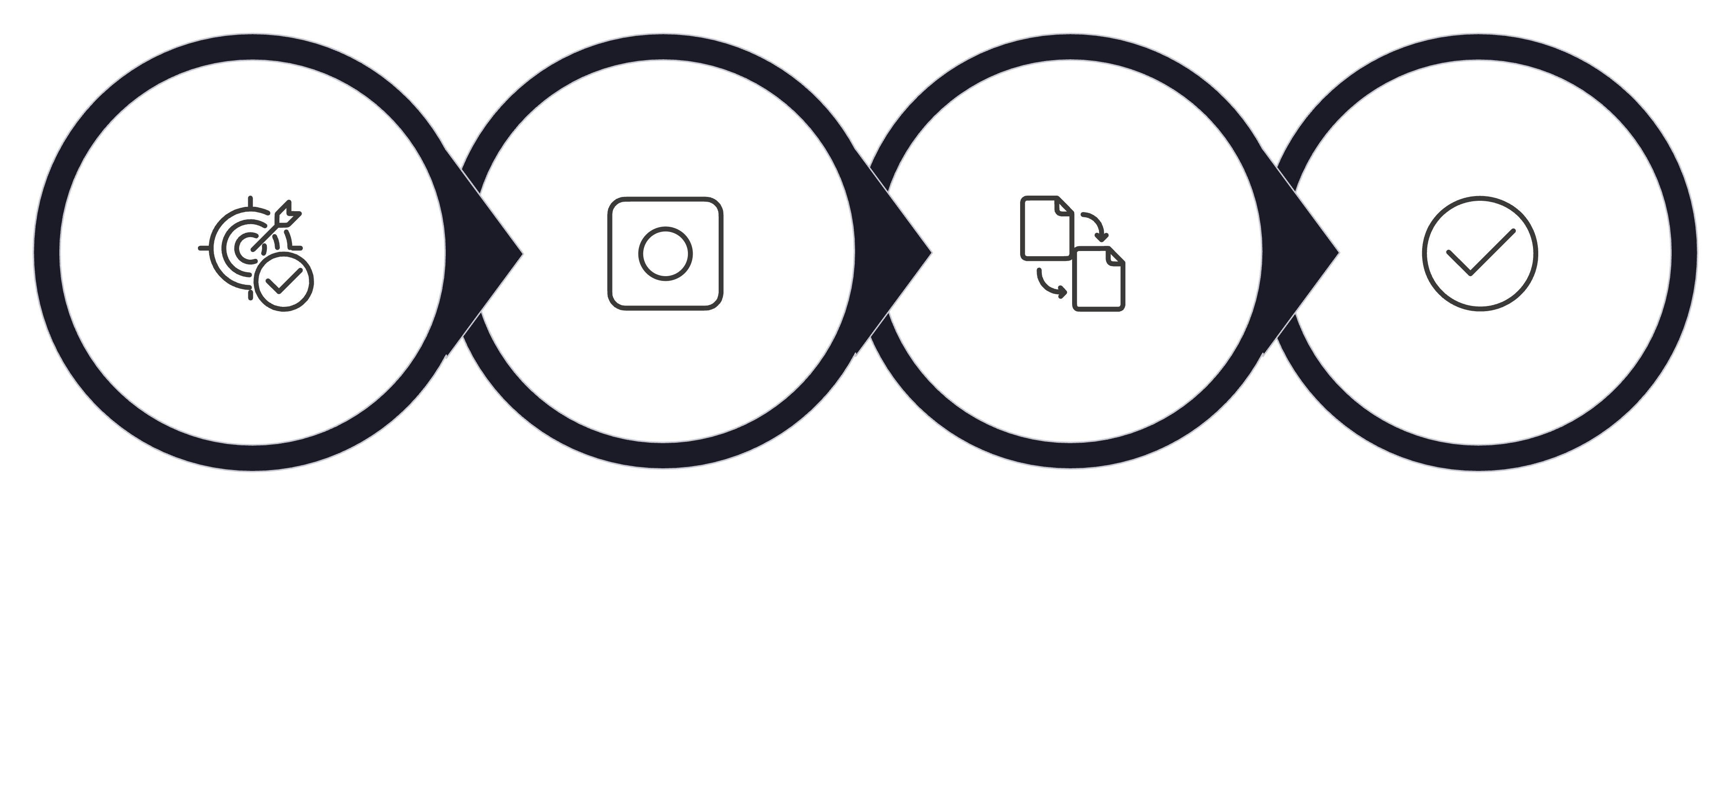
Iterations and Convergence
K-Means repeats the cycle — Assign → Recalculate → Assign → Recalculate — until the clusters stabilize and centroids stop moving.
Init Centroids
Assign Points
Recalculate
Final Clusters
Convergence
WCSS / Inertia
The algorithm has converged when centroid positions and cluster assignments no longer change between iterations. At this point, the algorithm stops.
K-Means minimizes the Within-Cluster Sum of Squares (WCSS) — also called inertia. Intuitively:
Convergence is guaranteed for standard K-Means
Typically reached in a small number of iterations
Results can vary depending on initial centroid placement
Minimize the total distance between each data point and the centroid of its assigned cluster.
Lower WCSS = tighter, more compact clusters. This is the objective K-Means optimizes at every iteration.

Slide 9
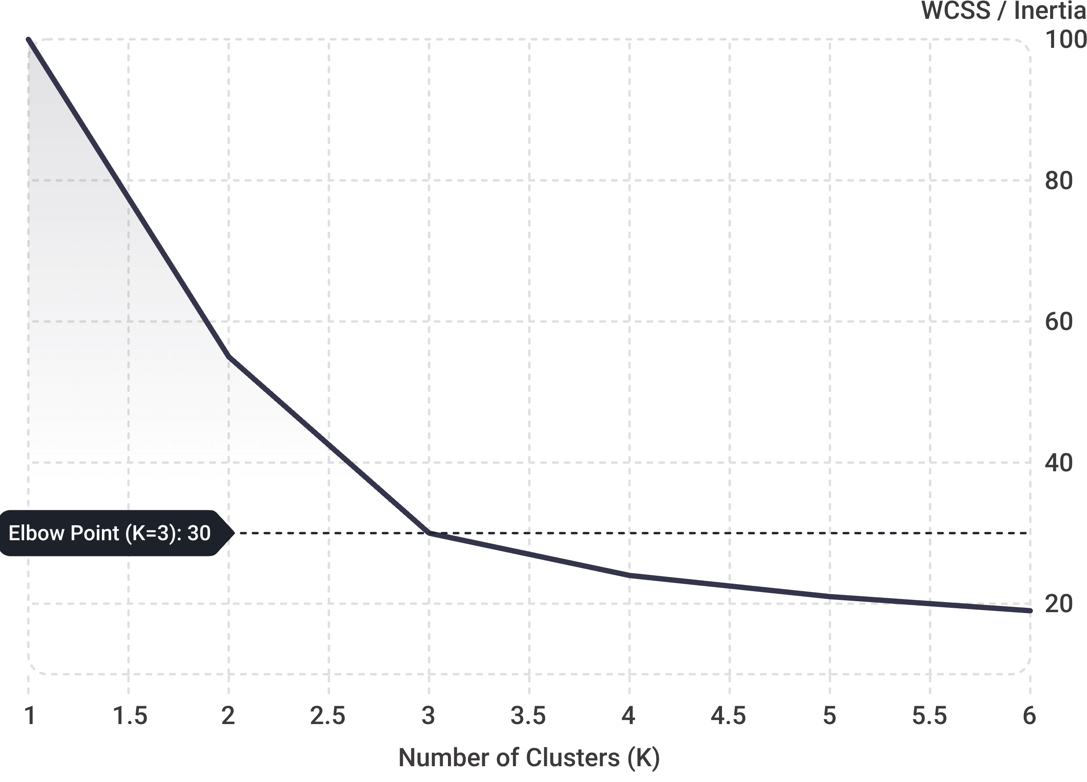

Choosing K: Elbow Method
K must be chosen before running K-Means. The Elbow Method helps identify the optimal K by plotting WCSS against the number of clusters.
Reading the Elbow
As K increases, WCSS always decreases — but the rate of improvement slows. The "elbow" is the point where adding more clusters yields diminishing returns.
WCSS drops sharply from K=1 to K=3
After K=3, the curve flattens significantly
K = 3 is the optimal choice for this dataset
The Elbow Method is a heuristic. Always combine it with domain knowledge and other validation methods.
Silhouette Score
Another evaluation method that measures how well-separated clusters are. A higher silhouette score indicates cleaner, more distinct cluster boundaries.

Slide 10
Summary & Real-World Applications
K-Means Workflow
Key Concepts
Real-World Applications
Unlabeled Data
Unlabeled Data → K-Means → Similar Groups → Business & Analytical Insights
Choose K
Initialize Centroids
Calculate Distances
Assign Points
Update Centroids → Repeat
Final Clusters
Unsupervised Learning
Centroid & Euclidean Distance
WCSS / Inertia
Elbow Method & Silhouette Score
Customer Segmentation
Image Compression
Recommendation Systems
Document Clustering
Anomaly Exploration
Social Media Audiences

